Slide 1

Ping Pong Game Project

Slide 2
Ping Pong Game Project Overview
Introduction
Project Goals
Tools Used
Game Overview
Interface Design
Ball and Paddle Movement
Scoring System
Code Overview
Challenges Faced
Future Improvements

Slide 3
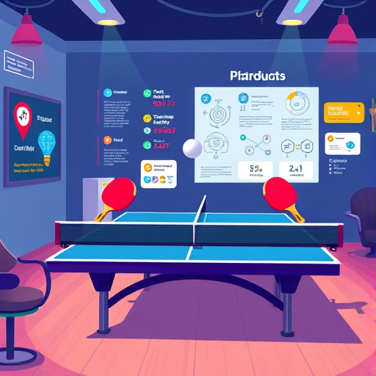
Introduction
Game Concept Overview: The Ping Pong game simulates a classic arcade experience, focusing on engaging gameplay and skill development.
Primary Objectives: Developing programming skills and delivering entertainment simultaneously, enhancing learning through interactive participation.
Educational Aspects: Players learn coding concepts while enjoying dynamic gameplay, fostering both cognitive and practical skills.

Slide 4
Project Goals
Fostering Creativity: The project encourages players to harness creativity, enabling custom game modifications and personalized experiences.
Programming Concepts: Participants grasp fundamental programming principles, enhancing problem-solving skills within an entertaining gaming context.
Enjoyable Experience: The game ensures a captivating experience, balancing educational content with fun, promoting sustained user engagement.

Slide 5
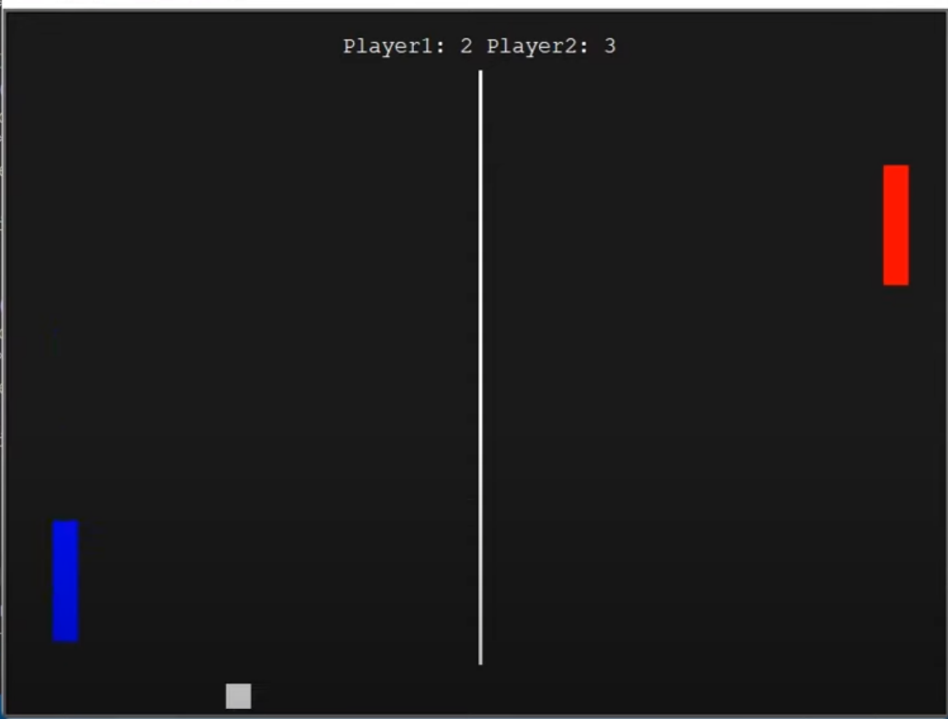
Tools Used
Python's Accessibility: Python's clear syntax and rich community libraries make it ideal for beginners learning programming efficiently.
Turtle Graphics Simplification: The Turtle library abstracts complex graphic functionalities, enabling immediate visual feedback for novice programmers.
Engaging Learning Tool: Using Python and Turtle promotes curiosity and exploration, enhancing both programming skills and creativity in users.

Slide 6
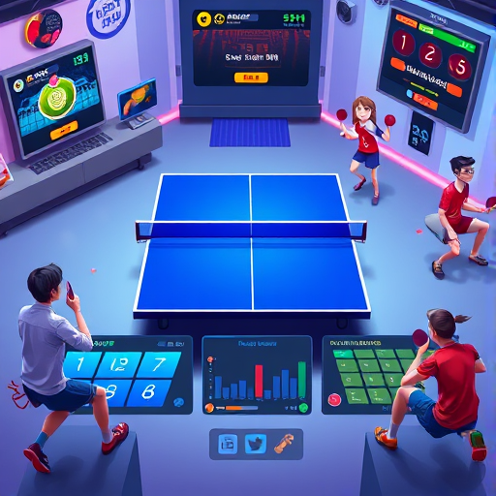
Game Overview
Game Launch Process: Players initiate gameplay by selecting options, loading the game interface, and configuring settings accordingly.
Gameplay Structure: The game follows a sequence of rounds, where players control paddles to bounce the ball strategically.
Victory Conditions: Achieving victory requires players to score a predetermined number of points while outmaneuvering their opponent.

Slide 7
Interface Design
Game Interface Design: The visual layout features a dynamic game screen with intuitive paddle designs and ball representation.
Paddle Functionality: Paddles are designed for responsive control, allowing players to impact ball movement accurately during gameplay.
Visual Feedback: Aesthetically appealing graphics enhance user engagement, contributing to improved learning and interactive experiences.

Slide 8
Ball and Paddle Movement
Ball Movement Logic: The ball's trajectory follows a constant velocity model with reflection based on collision angles.
Paddle Control Mechanics: Paddle movements are controlled through user input, enabling precise impact on the ball's direction.
Collision Detection: An iterative algorithm checks for overlaps, determining collision events and adjusting object trajectories accordingly.

Slide 9
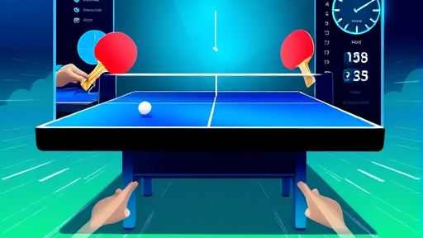
Scoring System
Scoring Mechanism: Points are awarded based on successful hits, recorded in a scoreboard for real-time tracking.
Player Points Tracking: Each player's score is incremented after every successful point, visible on the game interface.
Winning Criteria: The winner is determined when a player achieves the target score, concluding the match decisively.

Slide 10
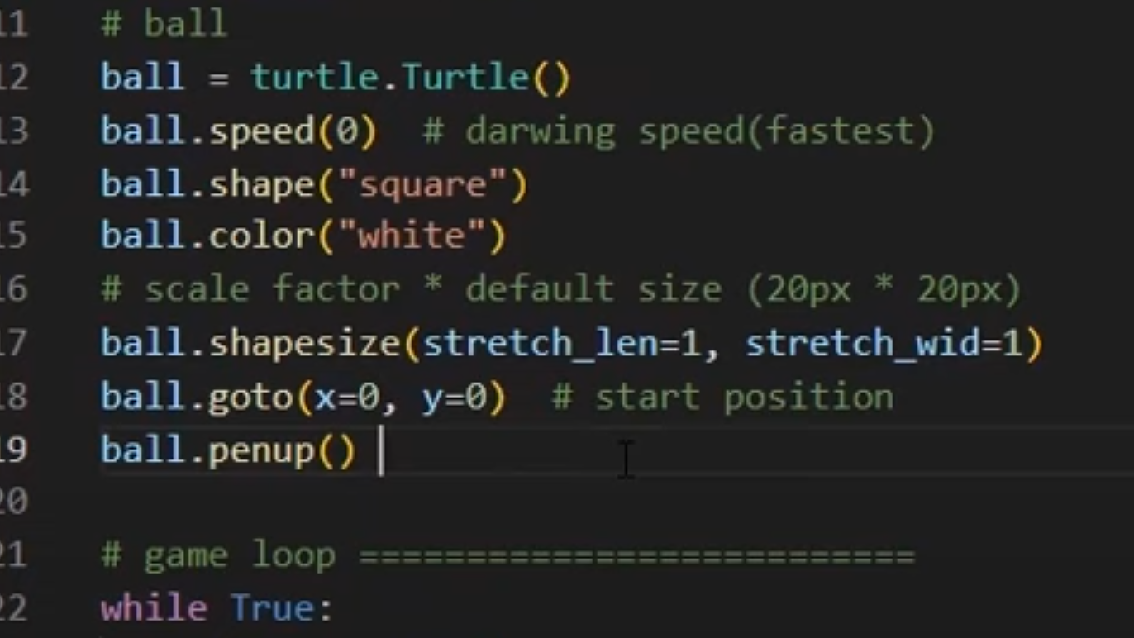
Code Overview
Movement Control Code: Key functions dictate the ball and paddle movements, ensuring responsiveness and fluid gameplay dynamics.
Collision Detection Function: The core algorithm efficiently identifies collisions, adjusting trajectories to simulate realistic interactions accurately.
Code Efficiency Considerations: Optimized code execution ensures smooth gameplay and reduces lag, enhancing the overall user experience significantly.

Slide 11
Challenges Faced
Common Bugs Encountered: Identified bugs included collision miscalculations, leading to inaccurate interactions during gameplay between objects.
Logic Problem Resolutions: Implemented conditional checks and debugging techniques to rectify inconsistencies in scoring and game flow logic.
User Feedback Utilization: Gathered player feedback to inform iterative improvements, enhancing gameplay balance and overall user satisfaction.

Slide 12
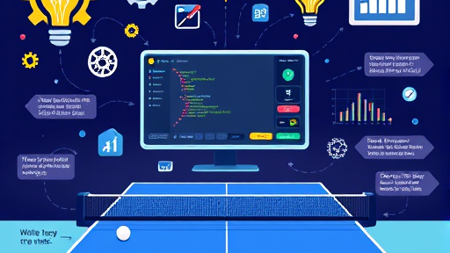
Future Improvements
Incorporating Sound Effects: Future iterations may include sound effects, enhancing immersion and stimulating player engagement through audio cues.
AI Opponents Development: Integrating AI opponents could create varied difficulty levels, providing challenges tailored to individual player skills.
Enhanced Graphics: Improving graphics quality will elevate the visual appeal, making the gaming experience more attractive and stimulating.

Slide 13
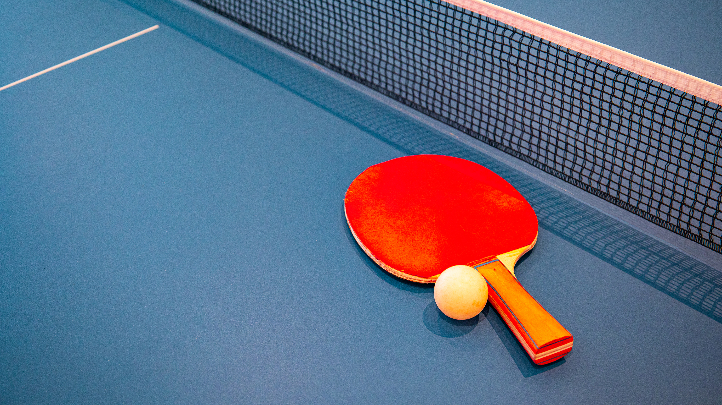
Educational Value
Logical Thinking Development: Participants enhance logical thinking abilities through systematic problem-solving and strategic game mechanics engagement.
Python Proficiency Gains: The project significantly deepens understanding of Python, reinforcing core concepts through hands-on programming challenges.
Turtle Library Familiarity: Utilizing the Turtle library enhances graphical programming fluency, fostering creativity in user-driven design implementations.

Slide 14
Thank you

